Slide 1

University Institute of Liberal Arts and Humanities
Course Name – Communication Skills
Course Code – 23PCH-105
Communication Skills- meaning, importance, and process
DISCOVER . LEARN . EMPOWER

Slide 2
COURSE OBJECTIVES
The Course aims to:
1 | Augment students overall communication and interpersonal skills by making them realize the importance of good oral and written English Language in professional life.
2 | Enrich their reading capability with special emphasis on expanding vocabulary and grammatical formations.
3 | Build exceptional speaking, reading and writing skills by correcting grammatical errors and pronunciation through practice.
4 | Enhances soft skills by fostering self awareness, confidence and a positive attitude in students’ ability to communicate effectively in English.

Slide 3
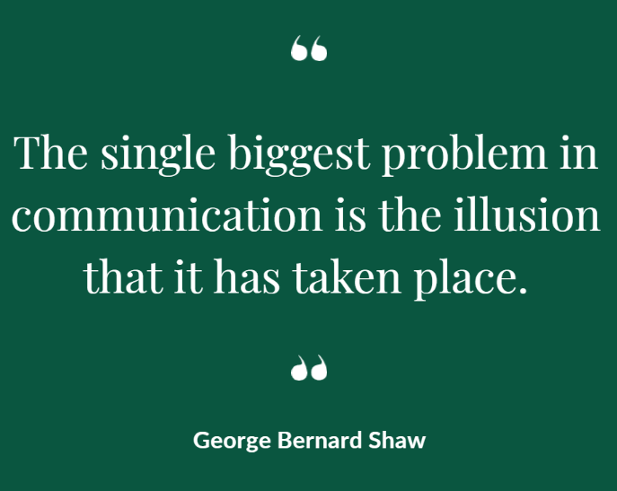
Course Outcomes
On completion, the students are expected to:
CO Number | Title | Level
CO1 | Apply appropriate Listening, Speaking, Reading and Writing Skills (LSRW Skills) with correct non-verbal cues to attain expertise in soft skills. | Apply
CO2 | Apply correct contextual and comprehensible written text in the form of paragraph writing, short compositions business correspondence, using logical support and argument in a wide range of communication situations. | Apply
CO3 | Demonstrate linguistic competence while speaking and during presentations through accuracy in grammatical usage, vocabulary, pronunciation and intonation. | Apply
CO4 | Evaluate information as critical readers, speakers and writers applying ethics in communication and being sensitive in cross cultural communication. | Evaluate
CO5 | Create original, digital content for websites, blogs, vlogs and personal social media profiles etc. | Create

Slide 4
“Half the world is filled with people who have something to say and cannot say it and the other half, of people who have nothing to say and keep on saying it”
- Robert Frost
Thirstt.com

Slide 5
What is Communication?
com·mu·ni·ca·tion
\kə-ˌmyü-nə-ˈkā-shən\
Derived from the Latin word “communicare”, meaning to share.
Communication is an exchange of thoughts, messages or information by speech, visuals, signals, writing, or behaviour.
Thirstt.com

Slide 6

Definition
“Communication is a process involving the selection, production and transmission of signs in such a way as to help a receiver perceive a meaning similar to that in the mind of the communicator.”
-Fotheringham
DeskAlerts.com

Slide 7
Why Effective Communication?
The ability to effectively communicate with others is one of the most important tools for professional and personal success.
It helps us better understand a person or situation and enables us to resolve differences and build trust and respect.
Your capacity to communicate is often seen as an indicator of your ability and intelligence.
DeskAlerts.com

Slide 8
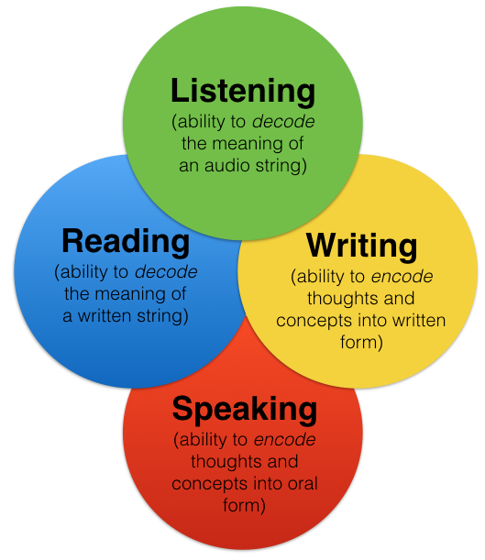
Language Skills
Types of languages in relation to Business Communication
Formal Language
Informal Language
Pinterest.com

Slide 9
Poll Question 1
What are the brain input Language Skills?
Reading and Speaking
Listening and Writing
Reading and Writing
Listening and Reading

Slide 10
Example of Poor Language Skills
One garbled Memo
When workloads increase to a level requiring hours in excess of an employee’s regular duty assignment, and when such work is estimated to require a full shift of eight (8) hours or more on two (2) or more consecutive days, even though unscheduled days intervene, an employee’s tour of duty shall be altered so as to include the hours when such work must be done, unless an adverse impact would result from such employee’s absence from his previously scheduled assignment.

Slide 11

Business Communication
Business communication is the sharing of information between people within or outside an organization that is performed for the commercial benefit of the organization.
effectivecommunicationadvice.com

Slide 12
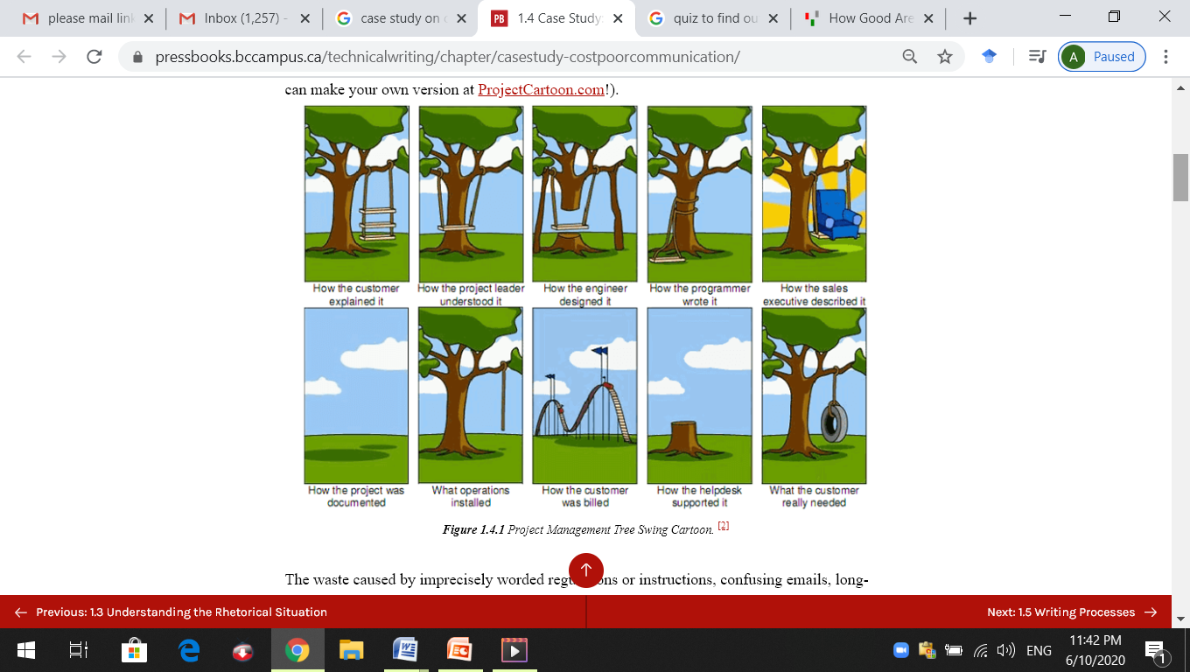
Perils of Poor Communication
Pressbooks.com

Slide 13
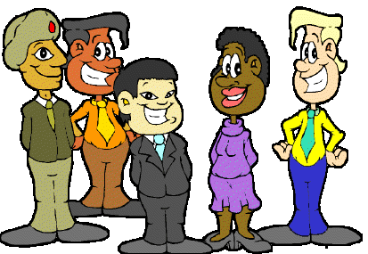
Importance
In the professional world, communication decides a person’s career curve - better the communication skills, higher are the chances of touching the zenith of success.
The new global and diverse workplace requires excellent spoken and written communication skills.
VitalSmartsIndia.com

Slide 14
The Communication Quiz
Statement | 1. Not at All | 2. Rarely | 3. Sometimes | 4. Often | 5. Very Often
If I don't understand something, I tend to keep this to myself and figure it out later.
When talking to people, I pay attention to their body language.
I'm surprised to find that people haven't understood what I've said.
Before I communicate, I think about what the person needs to know, and how best to convey it.
I consider cultural barriers when planning my communications.
https://www.mindtools.com/pages/article/newCS_99.htm

Slide 15
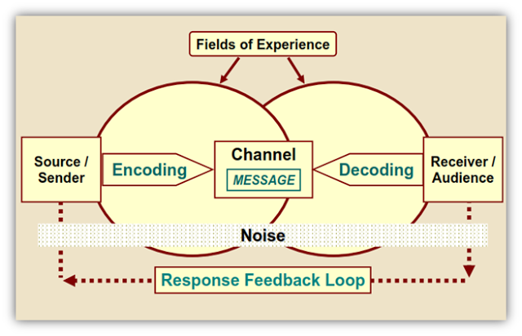

Slide 16
Process of Communication
The formation of communicative motivation or reason.
Information is encoded, channeled and sent by a sender to a receiver via some medium.
All forms of communication require a sender, a channel, a message, a receiver and the feedback.
A hindrance in the communication process is called noise.
8

Slide 17
Case Study- The co-op student who mixed up genres
Chris was simultaneously enrolled in a university writing course and working as a co-op student at the Widget Manufacturing plant. As part of his co-op work experience, Chris shadowed his supervisor/mentor on a safety inspection of the plant, and was asked to write up the results of the inspection in a compliance memo. In the same week, Chris’s writing instructor assigned the class to write a narrative essay based on some personal experience. Chris, trying to be efficient, thought that the plant visit experience could provide the basis for his essay assignment as well.
He wrote the essay first, because he was used to writing essays and was pretty good at it. He had never even seen a compliance memo, much less written one, so was not as confident about that task. He began the essay like this: On June 1, 2018, I conducted a safety audit of the Widget Manufacturing plant in New City. The purpose of the audit was to ensure that all processes and activities in the plant adhere to safety and handling rules and policies outlined in the Workplace Safety Handbook and relevant government regulations. I was escorted on a 3-hour tour of the facility by…
Chris finished the essay and submitted it to his writing instructor. He then revised the essay slightly, keeping the introduction the same, and submitted it to his co-op supervisor. He “aced” the essay, getting an A grade, but his supervisor told him that the report was unacceptable and would have to be rewritten – especially the beginning, which should have clearly indicated whether or not the plant was in compliance with safety regulations. Chris was aghast! He had never heard of putting the “conclusion” at the beginning. He missed the company softball game that Saturday so he could rewrite the report to the satisfaction of his supervisor.
http://www.exec-comm.com/about-us/case-studies/

Slide 18
Examine the case and determine the following:
Define the rhetorical situation: Who is communicating to whom about what, how, and why? What was the goal of the communication?
Identify the communication error?
Explain the losses that were incurred by this problem.
Identify possible solutions or strategies that would have prevented the problem.

Slide 19
Applications
Applicable to both personal and professional life:
In personal life, good communication skills can improve your personal relationships by helping you to understand others, and to be understood.
Professionally, if you are applying for jobs or looking for a promotion, you will almost certainly need to demonstrate good communication skills.
Communication skills can also ensure that you are able to manage interactions with businesses and organisations.

Slide 20
Assessment Pattern
Students are assessed on the basis of the following parameters:
Hourly Test-2
Assignments
Surprise Test
Worksheets
Quiz
Student Engagement
End Semester Exam

Slide 21
References
Raman, M. and Sharma, S. (2017). Technical Communication - Principles and Practice, Oxford University Press: New Delhi
https://nptel.ac.in/courses/109/104/109104030/
www.managementstudyguide.com/business_communication.htm
www.skillsyouneed.com/ips/communication-skills.html
www.pressbooks.bccampus.ca/technicalwriting/chapter/casestudy-costpoorcommunication/
www.notesdesk.com/.../business-communications/business-communication-
https://www.ndsu.edu/fileadmin/staffsenate/Staff_Development/EFFECTIVE_COMMUNICATION_-_Staff_Senate.pptx

Slide 22
THANK YOU
For queries
Email: communicationskills.uilah@gmail.com

